Slide 1


DSA-CEP
Group members :
Muhammad Sabeeh Waqas
Syed Muhammad Hasan
Mirza Haider
Syed Muhammad Ali Naqi
Course :
BEE-56D

Slide 2
Problem Statement:
Complex Engineering Problem
You are required to develop a python code for Pakistan International Airlines (PIA) for flight reservation. Code must be user-friendly and will cover all the aspects of basic reservation system.
Objectives
Your code must show the following interface:
List of Flights: (Should show all the flights that PIA offers )
Flight Information (Time of departure, Domestic/International, Flight duration, City of Arrival and departure)
Book Flight (Name of traveler, Phone number, Email, Time of departure, Domestic/International, Flight duration, City of Arrival and departure, Booking number). Once the flight is confirmed, all the information is saved on a text file, which the passenger may consider as a ticket
Cancel Flight (Cancel flight against booking number (if present))
View Booking Details (View all details of booked flight against booking number)
Search flight
search booking/ticket
Create a trip: User can create a trip, means having a series of intermediate destinations. He may add or delete a destination so the cost will vary accordingly
Cancel trip:- Depends upon the rules of flight cancellation
Assumptions:
Each aircraft of PIA has capacity of 200 passengers
Business class-10 seats
A class-20 seats
Economy class-170
Rate:
Rs.15/Km for Economy Class
Rs. 25/Km for A class
Rs 35/Km for Business class
Child fare(under 12 years)is 75% of the total fare
If someone wants to book ticket still after 100 bookings, he/she may be assigned reserved seat. If someone cancel the booking the extra reservation would be adjusted in priority-wise, otherwise he may be assigned a confirm seat in the next available flight
Cancellation of flight.
100% refund if cancellation is done 72 hours prior to the flight
75% refund if cancellation is done 48 hours prior to the flight
50% refund if cancellation is done 24 hours prior to the flight
25% refund if cancellation is done 12 hours prior to the flight
No refund if cancellation is done less than 12 hrs of departures
Deliverables
.py file
Presentation
Report (Description of program and Screenshots of output and code)
NOTE: To de done in groups of 3/4
Submission date: 1st feb 2021, 2nd feb2021, 8 feb 2021 and 9 feb 2021( As students will come to university in groups so they will present their work on their respective days)

Slide 3
Data structure used:
Linked list
Queue
Python list

Slide 4
Linked List Domestic:
Flights
PK011
…..
…..
…..
…..
…..
DOM
M
Passengers per flight
Flights per week

Slide 5
Linked List International:
Flights
……
……
……
……
INT
PK109
……
……
M
Passengers per flight
Flights per week

Slide 6
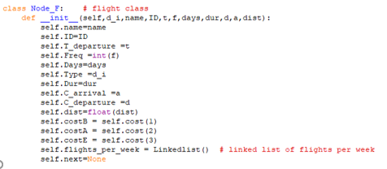
Flights Node structure
ID
Freq
Days
Type
Dur
C_arrival
C_departure
dist
costB
costA
costE
next
name
T_departure
Flights_per_week

Slide 7
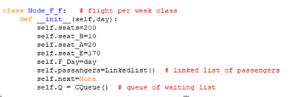
Flight per week Node structure
seats
seat_B
seat_E
F_Day
passangers
next
seat_A
Q

Slide 8
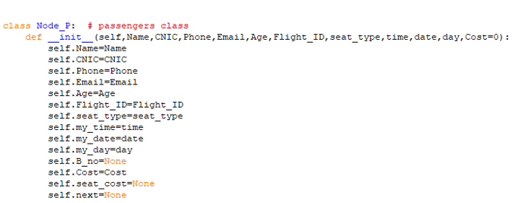
passengers Node structure
seat_type
my_time
my_date
B_no
Seat_cost
Name
CNIC
Phone
Email
Age
Flight_ID
my_day
Cost
next

Slide 9
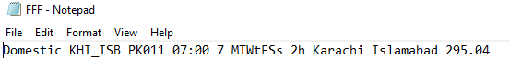
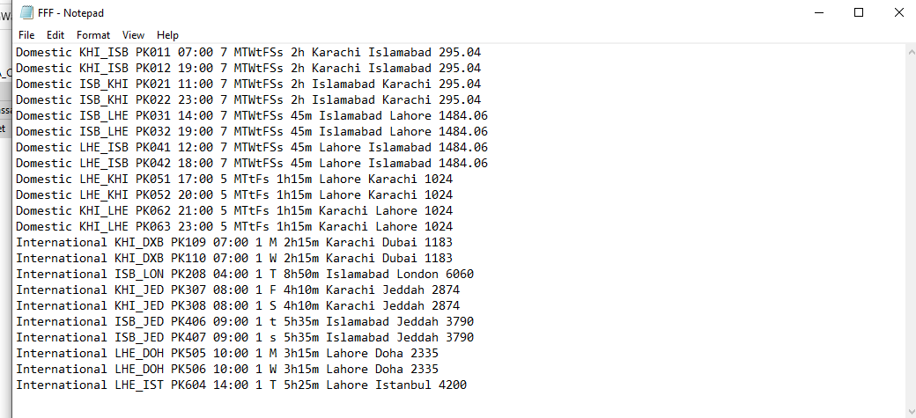
FFF file syntax:

Slide 10
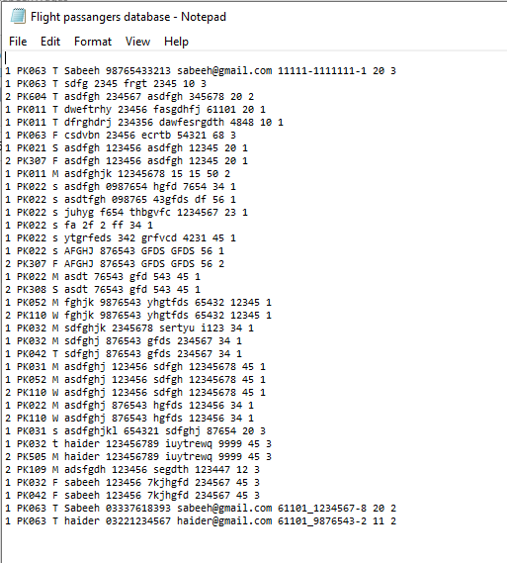
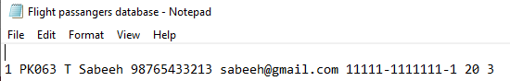
Flight database syntax:

Slide 11
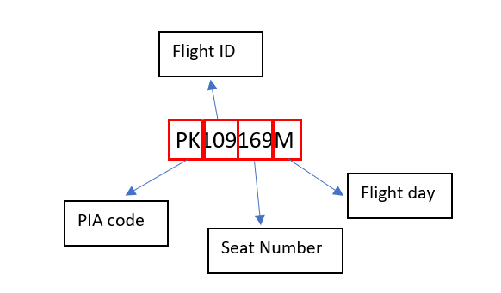
Booking Number syntax:

Slide 12
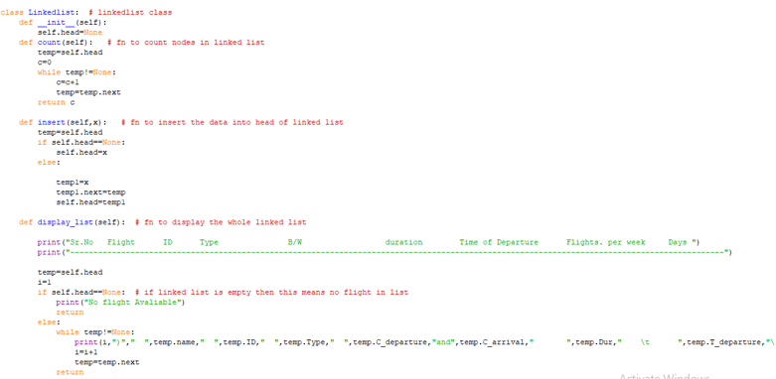
Linked List Class :

Slide 13
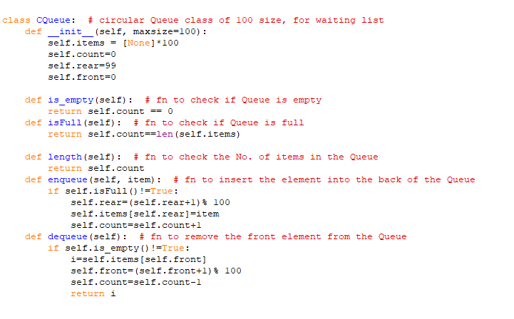
Queue Class (for waiting list):

Slide 14
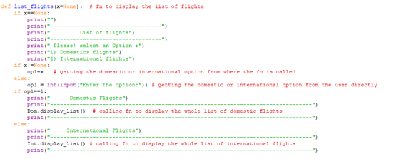
1) Function to list Flights:
Function to list the flights that PIA offers

Slide 15
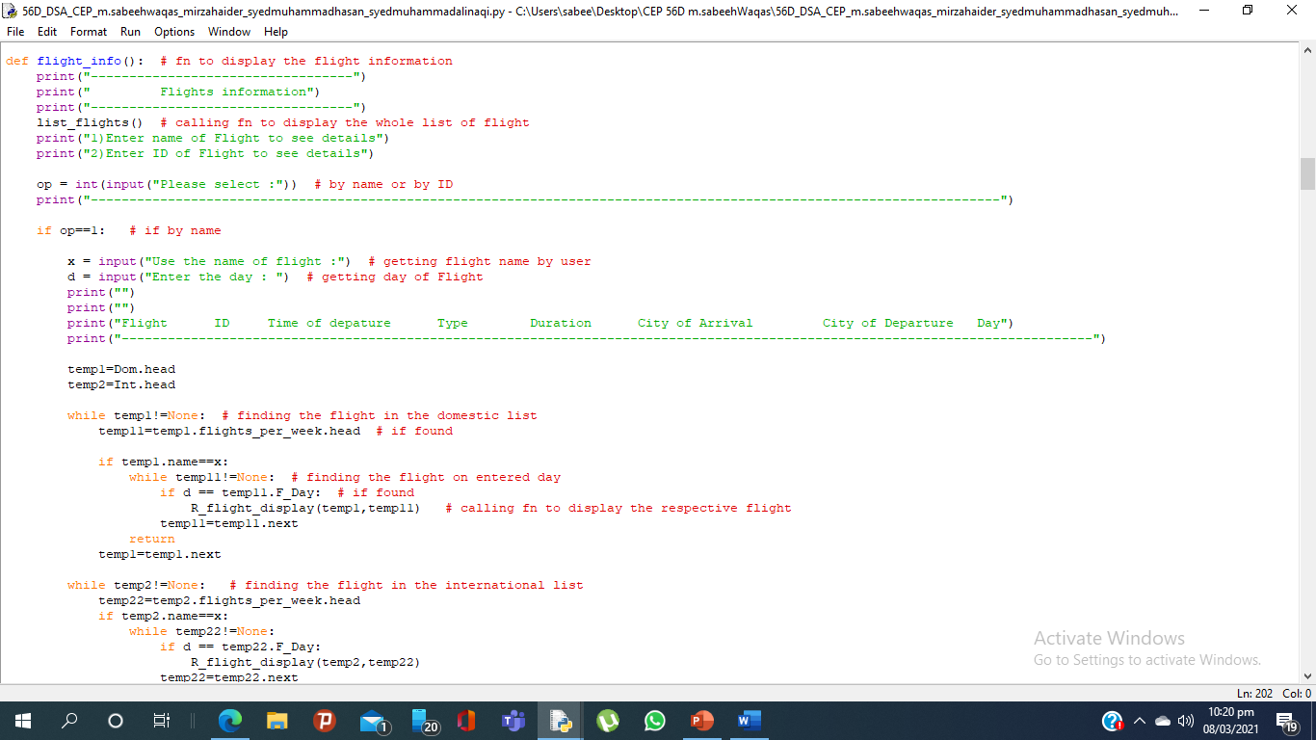
2) Function of Flight information:
Function to show the detail of the flights such as no. of seats , no. of booking and etc

Slide 16
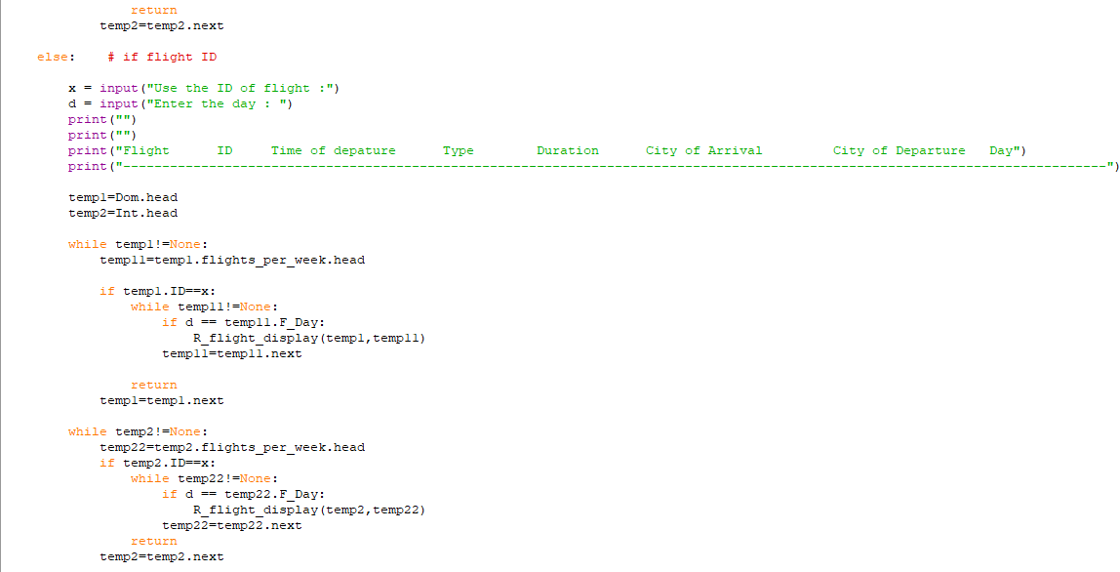

Slide 17
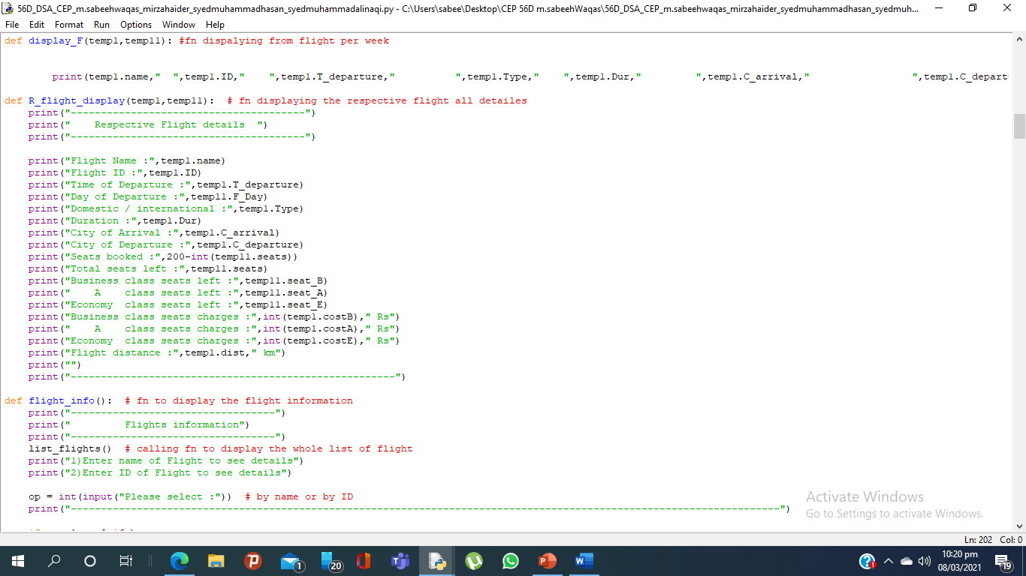
i)Supporting Functions:
Function to display flights all details such as seats,booking no. etc

Slide 18
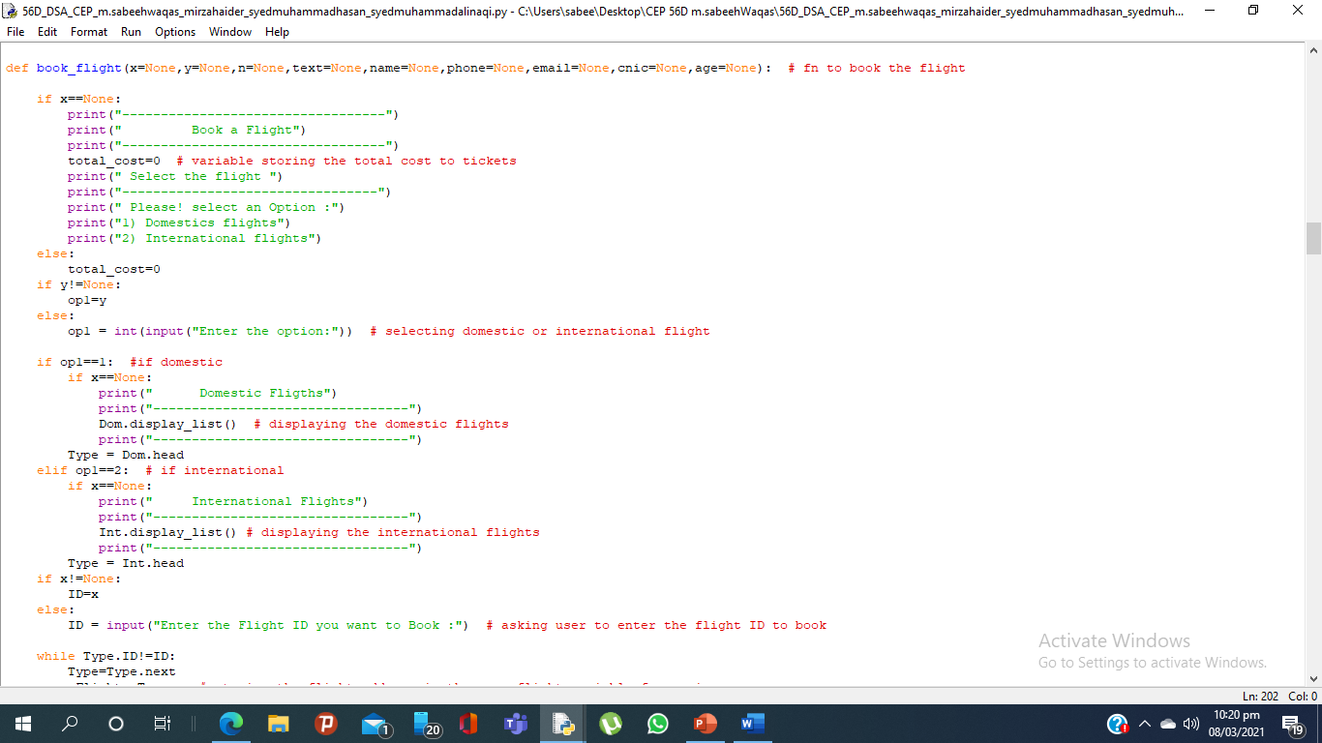
3) Function of Book a Flight:
Function to book the flight of the user and making its ticket as a txt file ,while maintain collsion and cnic check and etc

Slide 19
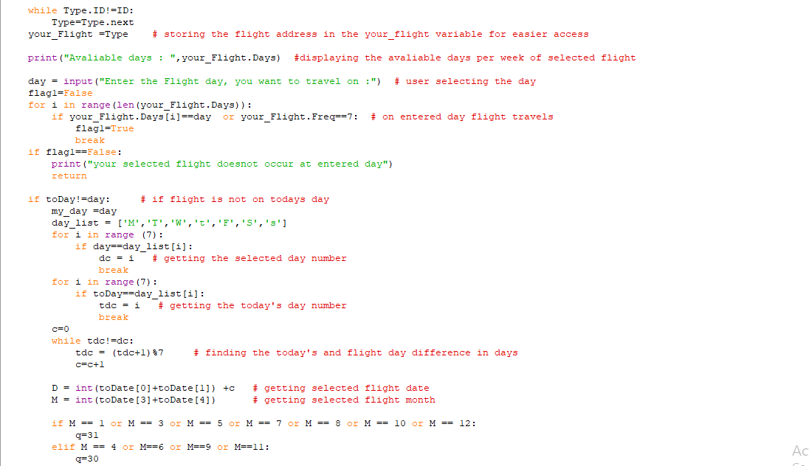

Slide 20
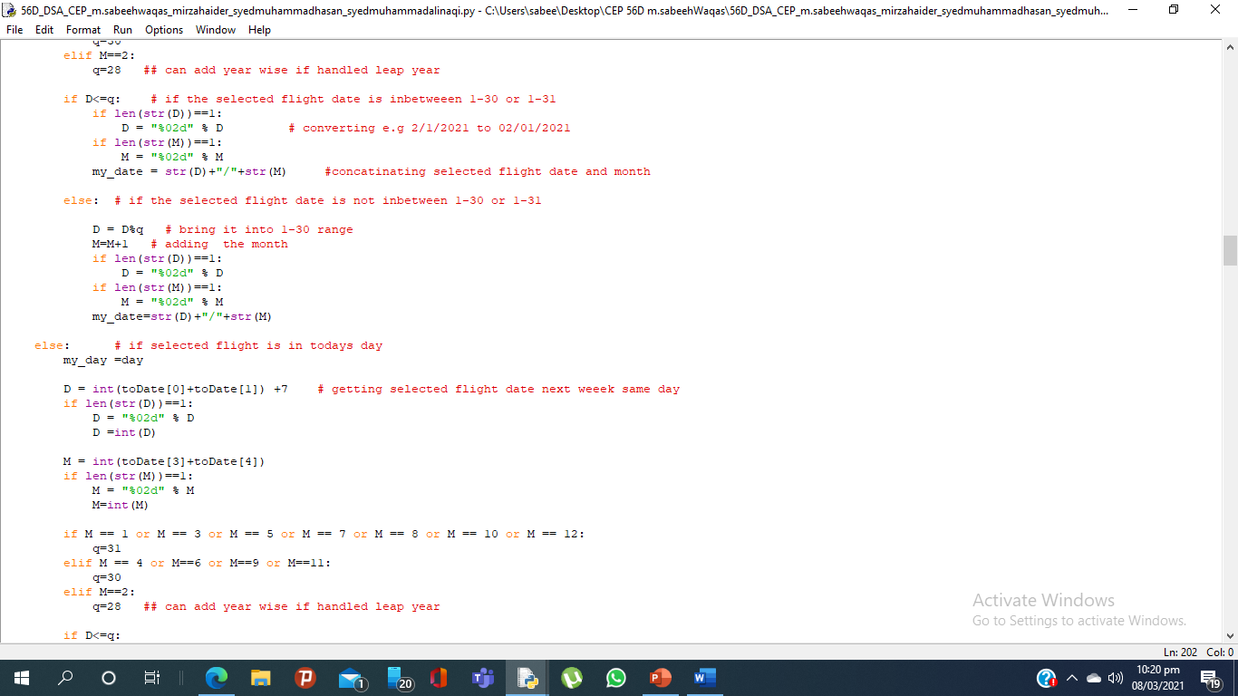

Slide 21
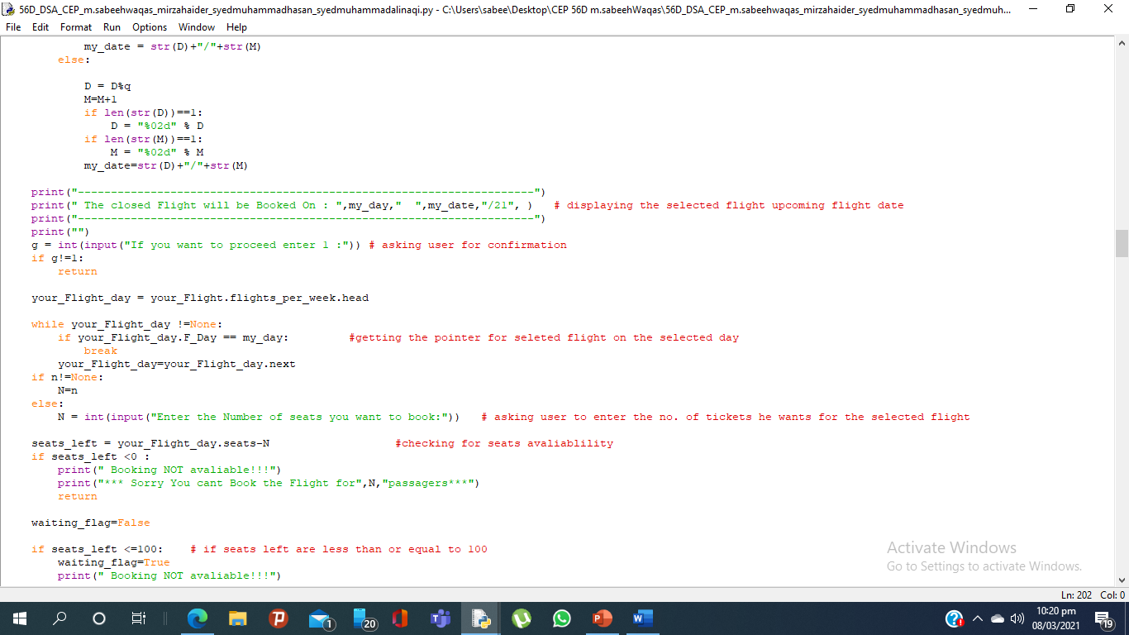

Slide 22
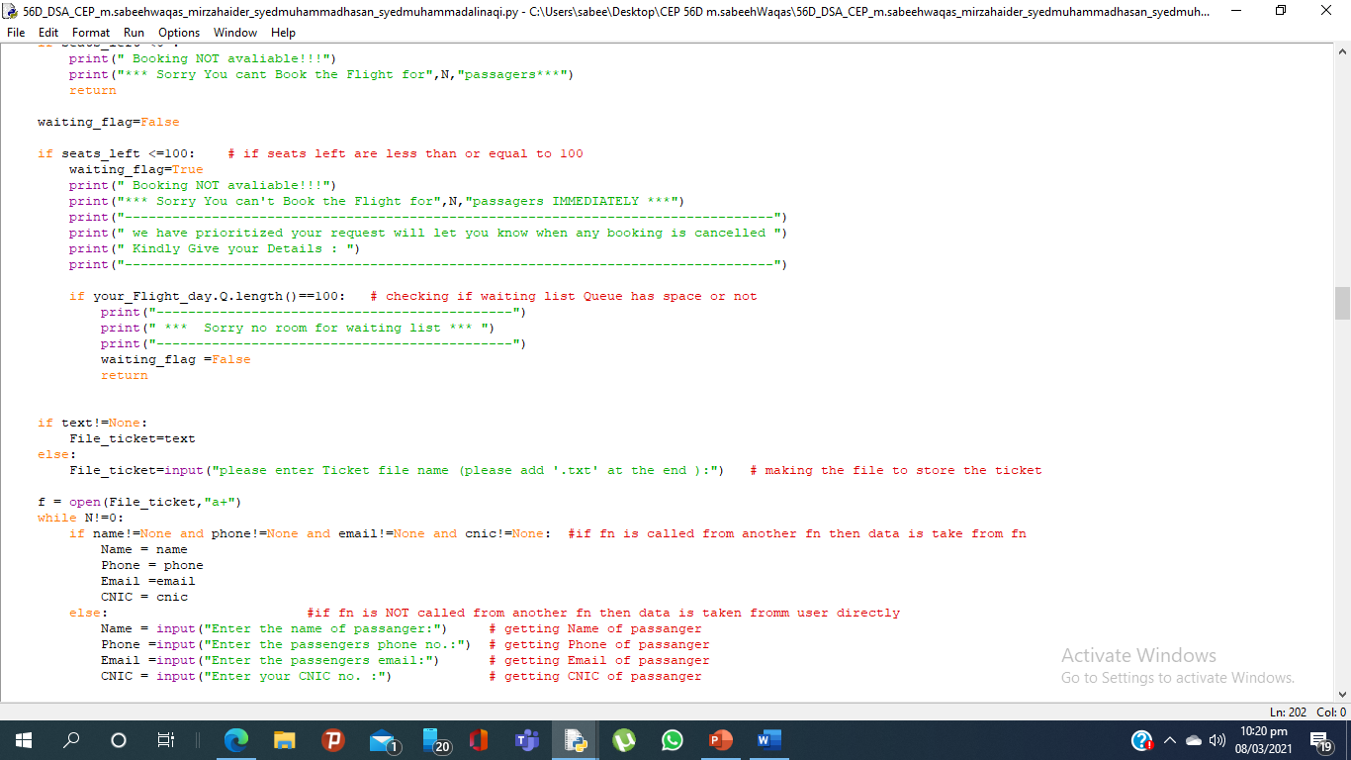

Slide 23
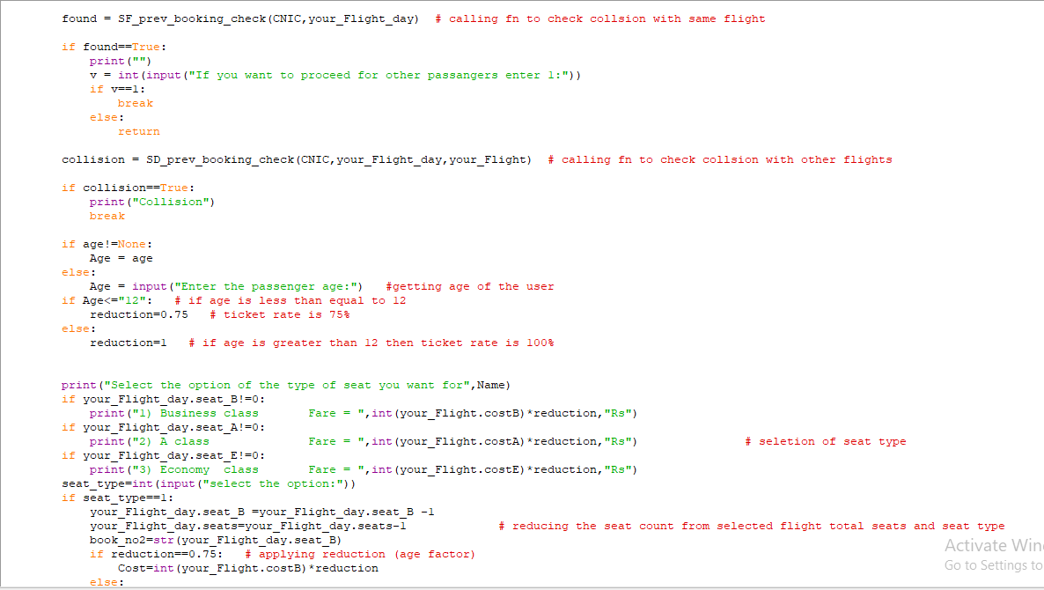

Slide 24
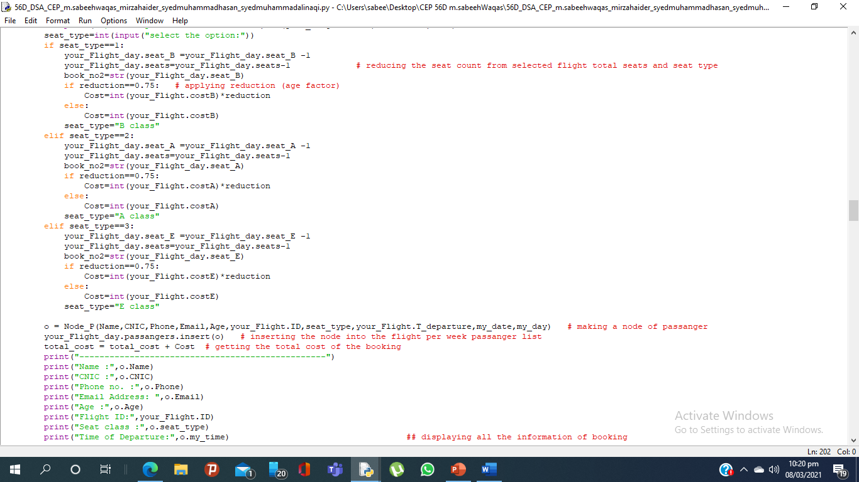

Slide 25
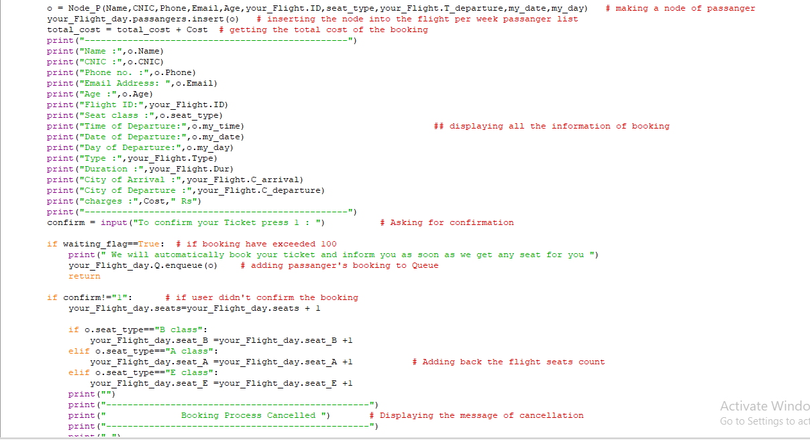

Slide 26
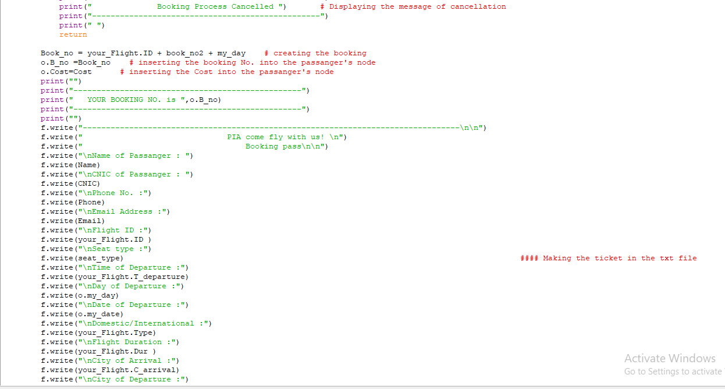

Slide 27
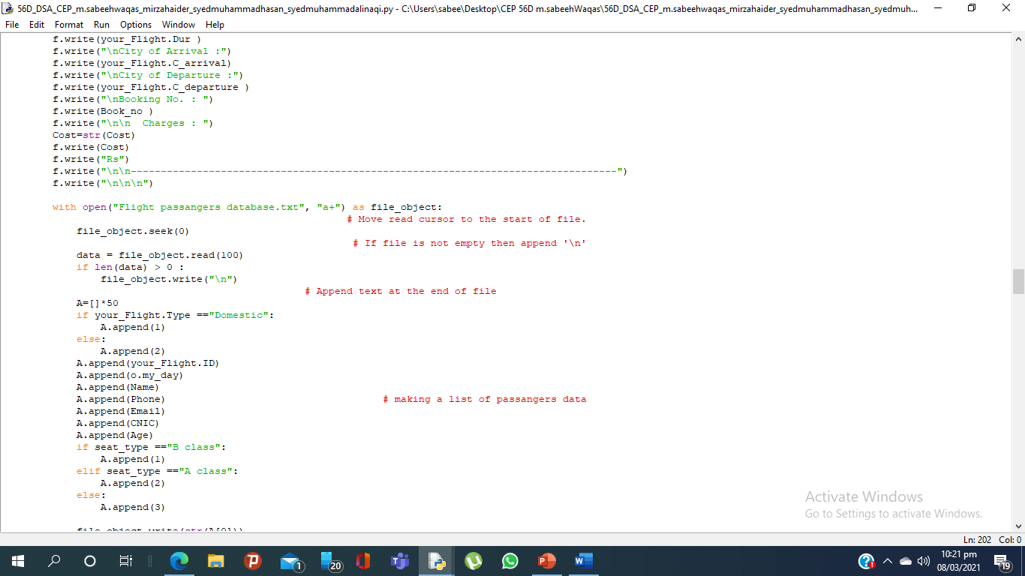

Slide 28
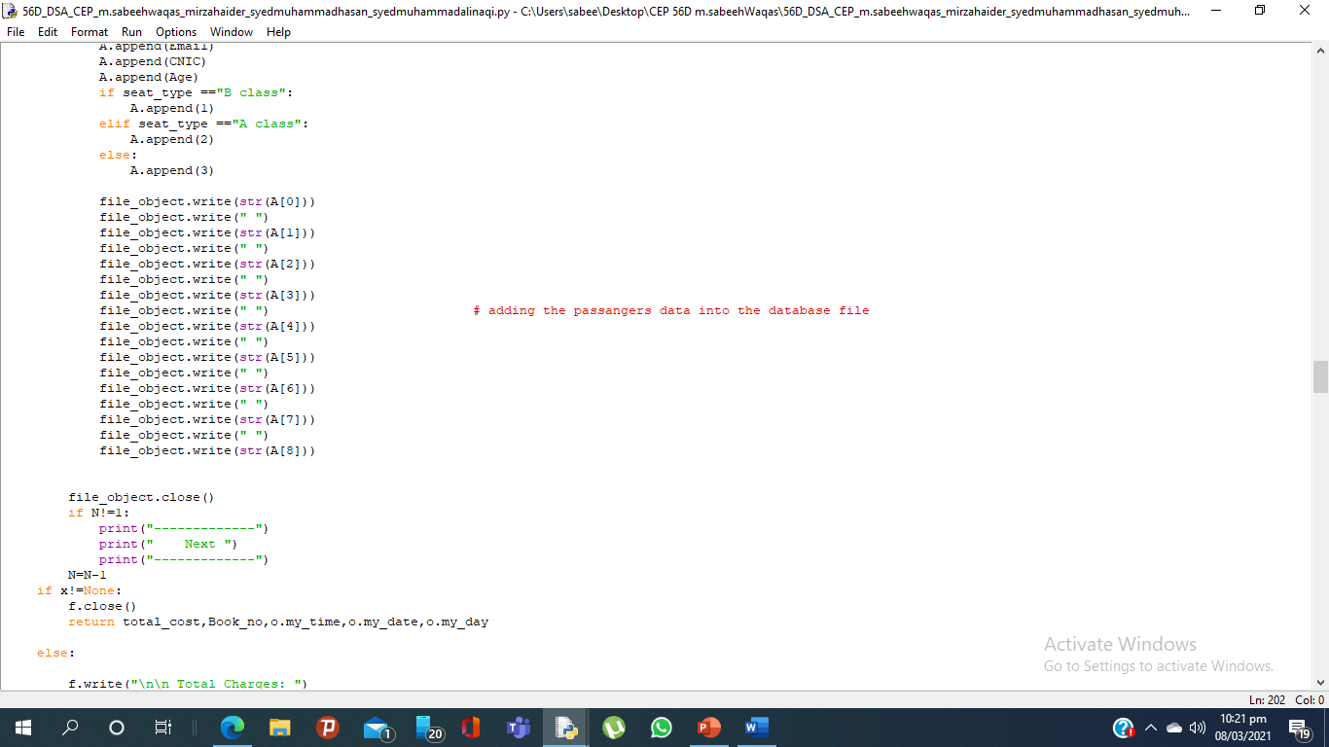

Slide 29
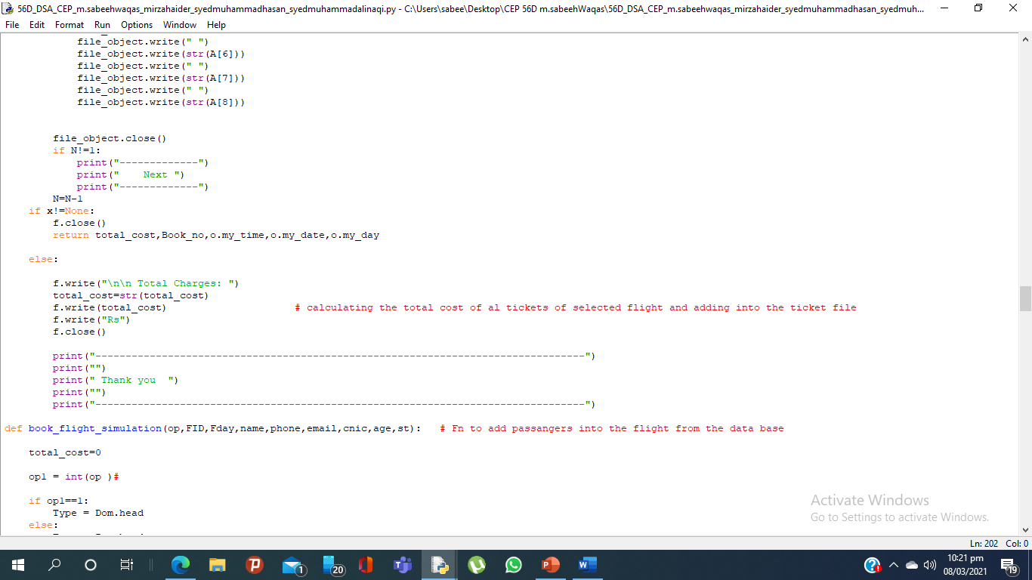

Slide 30
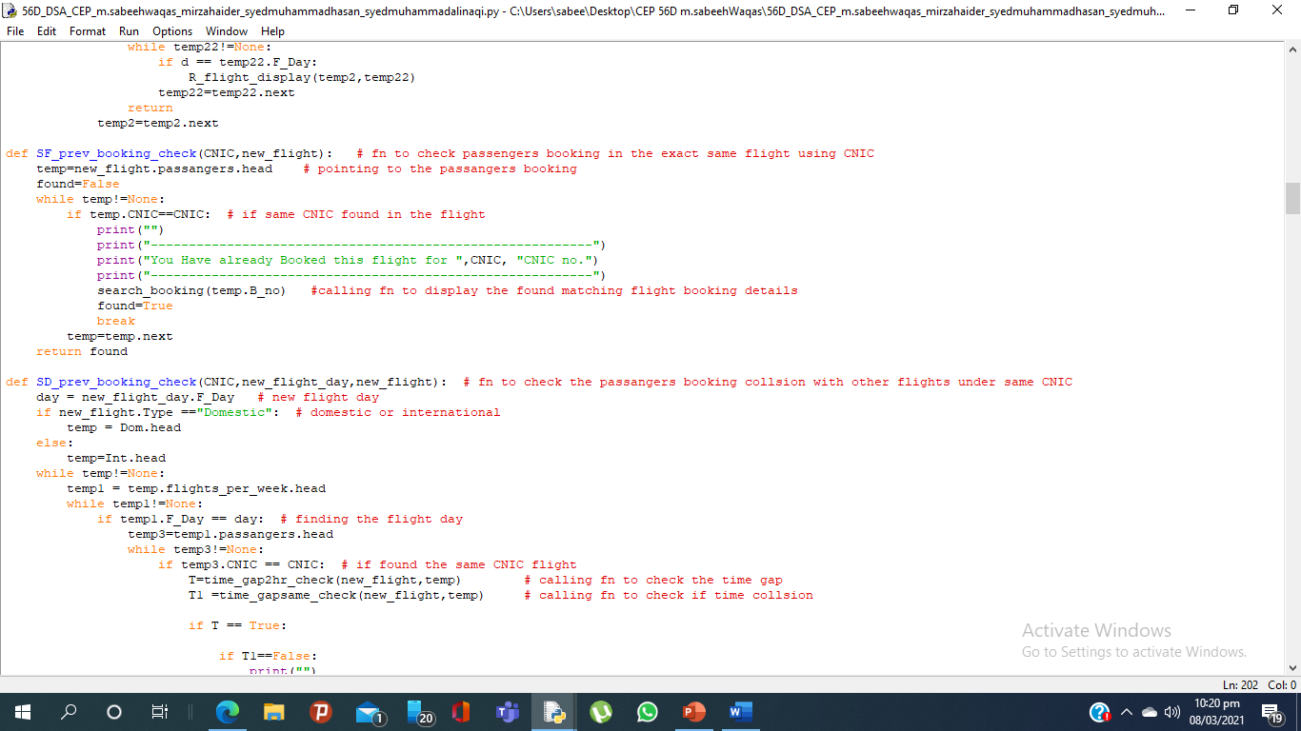
i)Supporting Functions:
Function to check if user with the same CNIC has already booked the seat in the flight

Slide 31
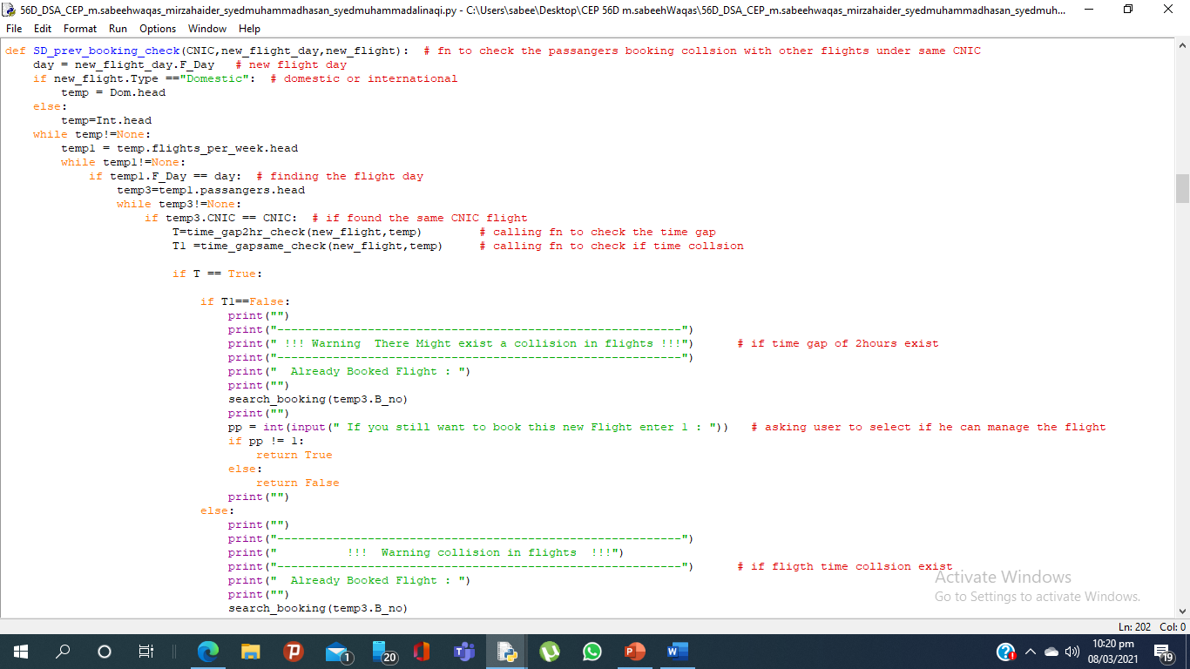
ii)Supporting Functions:
Function to check if user has collision with other flights (collision can occur if gap less than 2 hrs)

Slide 32
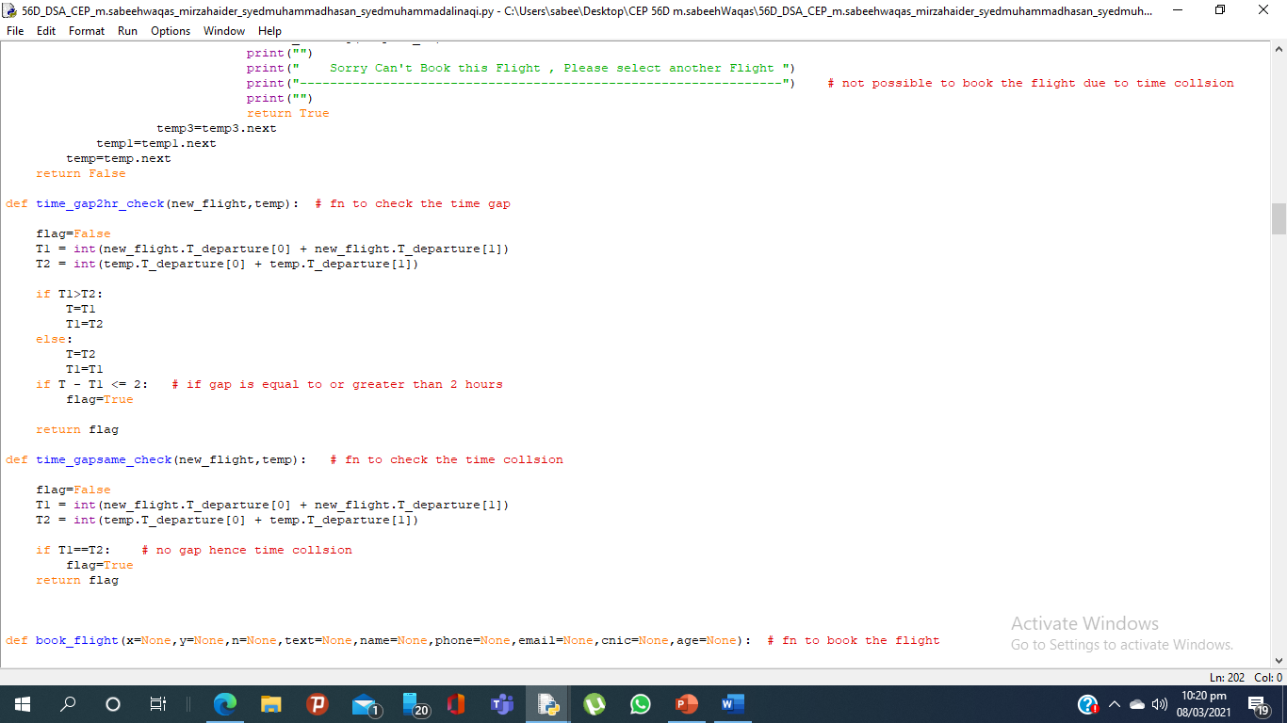
iii)Supporting Functions:
Functions to check the time gap between new and already boked flight of user

Slide 33
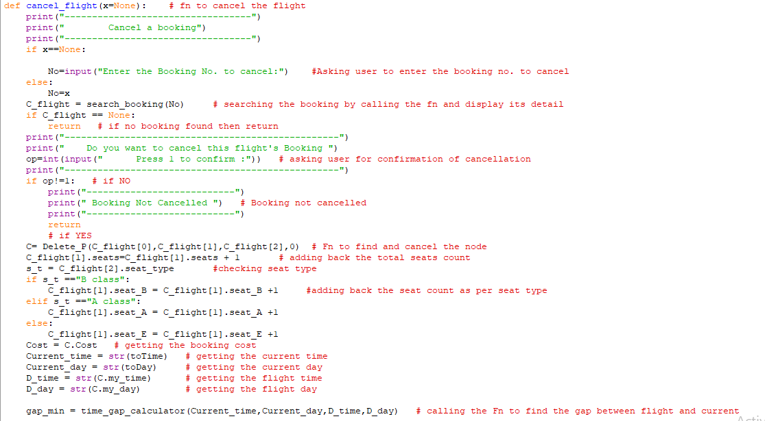
4) Function to Cancel a Flight:
Function is used to cancel the flight of the user if booked
Note: it does not gets deleted from the database file as database file is for simulation purpose only

Slide 34
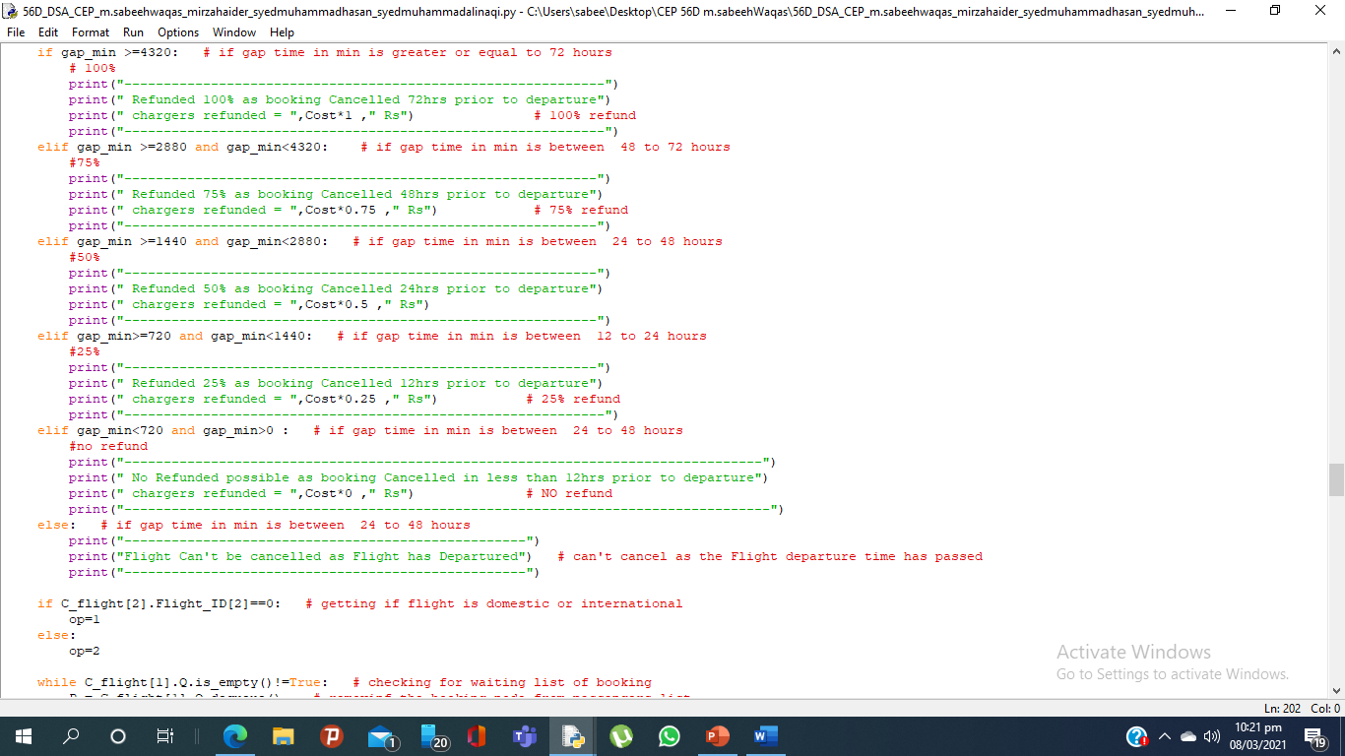

Slide 35
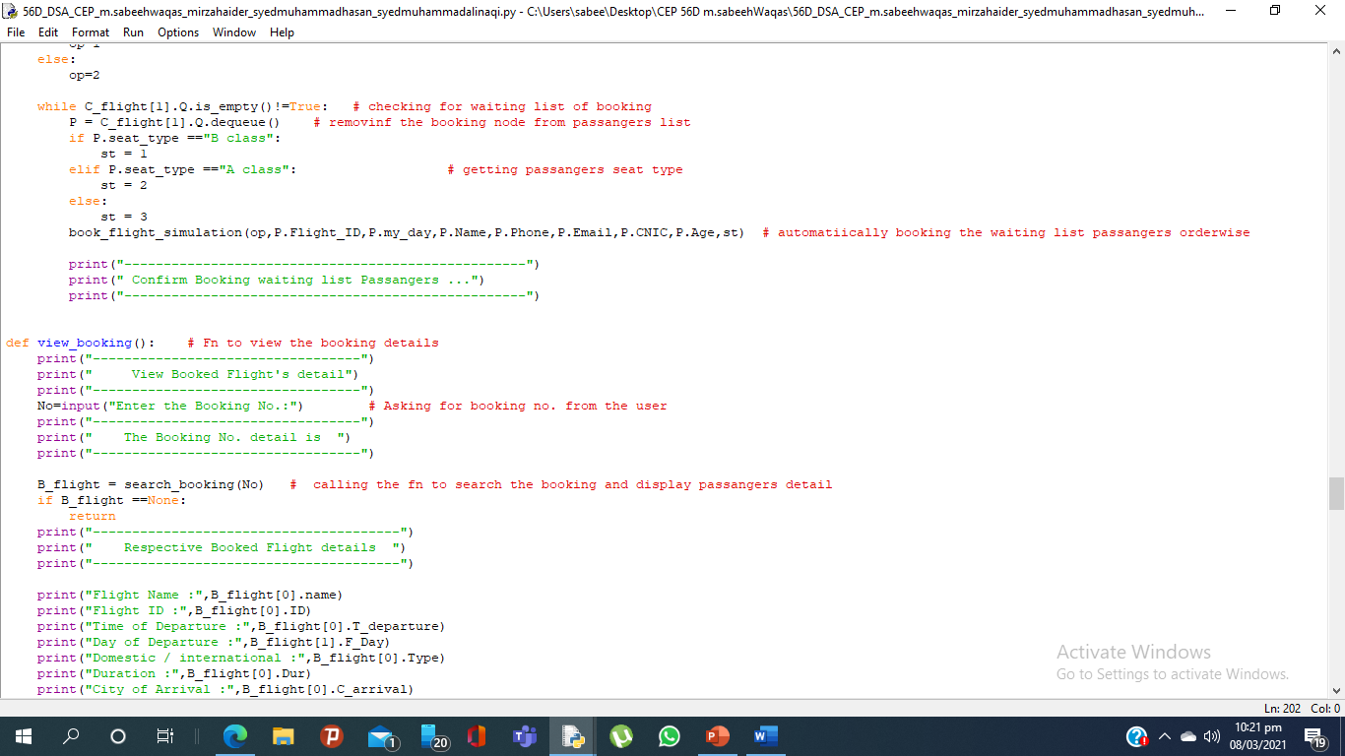

Slide 36
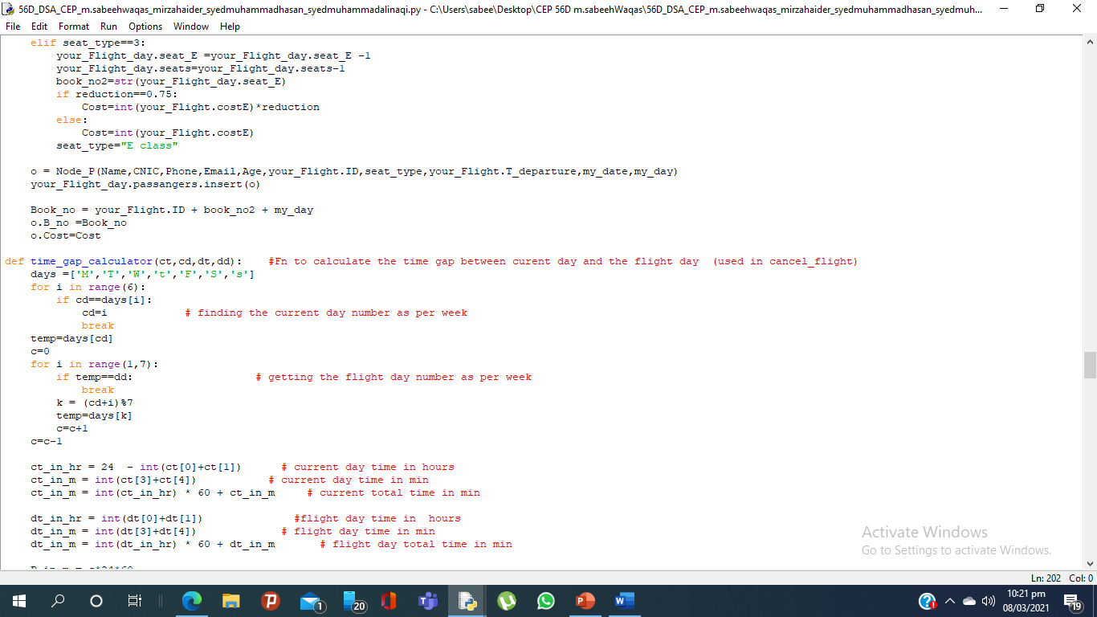
i)Supporting Functions:
Functions to calculate the time gap between current day and the flight day

Slide 37
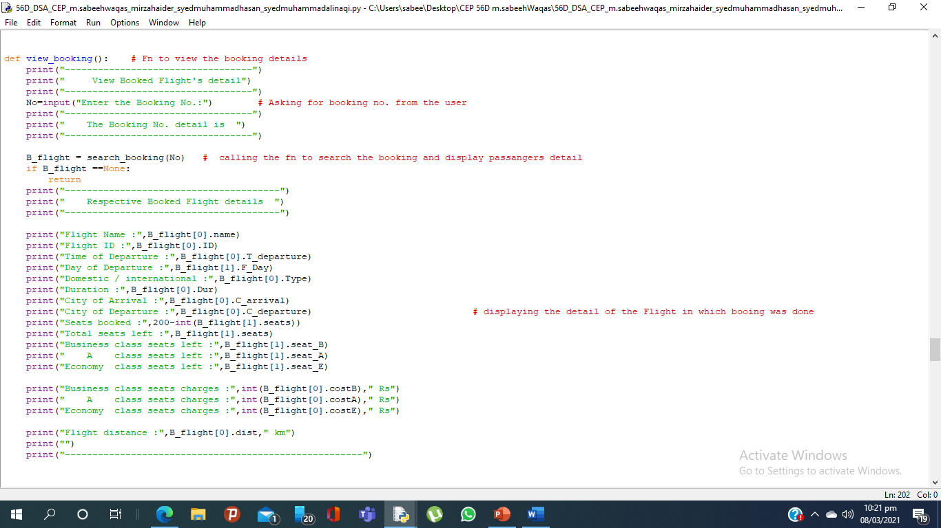
5) Function to View Booking :
Function is search the booking of flight of user through searching from the list via the booking no, given by the user

Slide 38
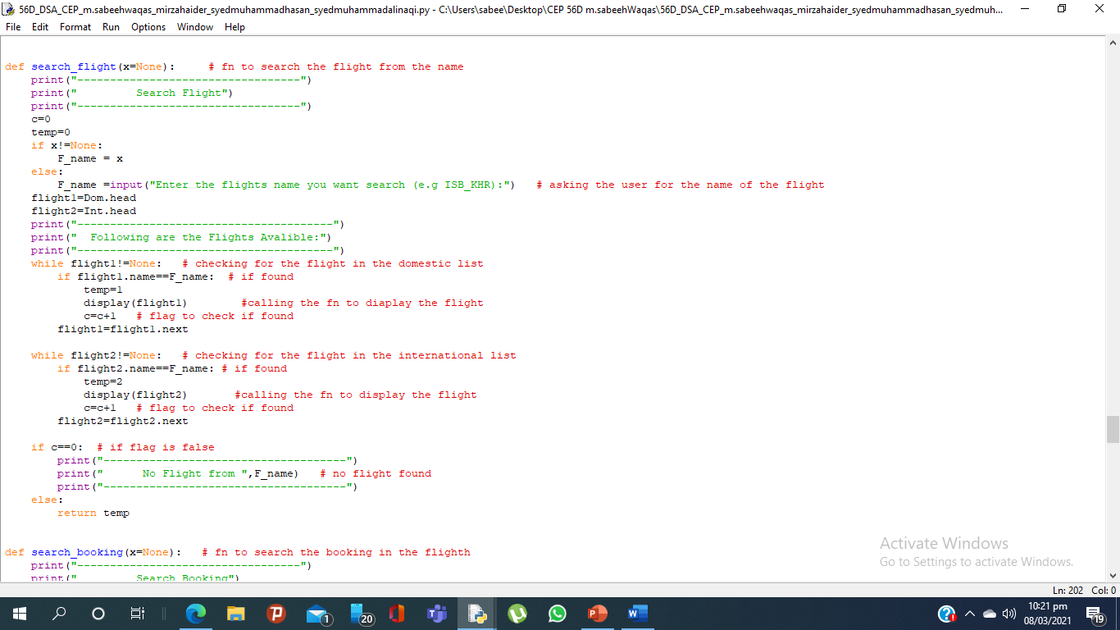
6) Function to Search Flight:
Function is used to search the flight from PIA flight linked list , user has to enter the flight name e.g ISB_LHE

Slide 39
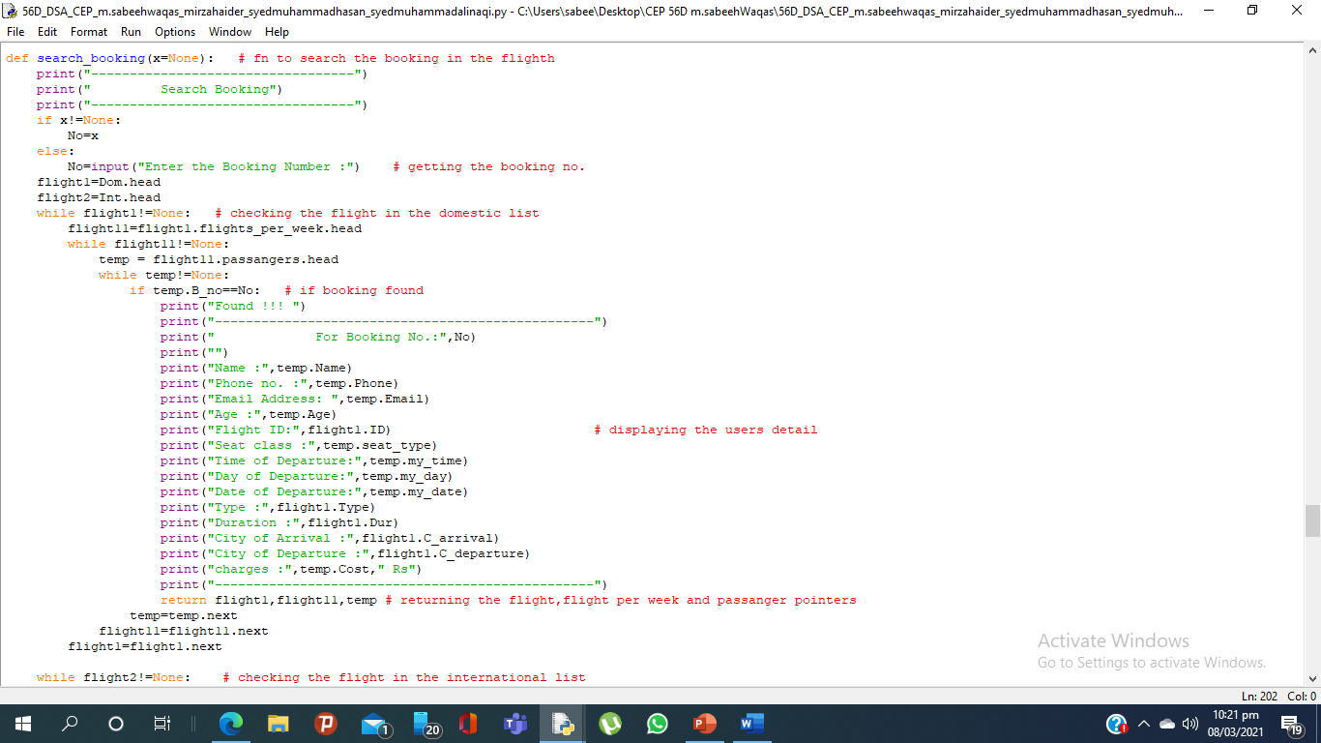
7) Function to Search Booking:
Function is used to search the flight detail and booking details for the given booking number

Slide 40
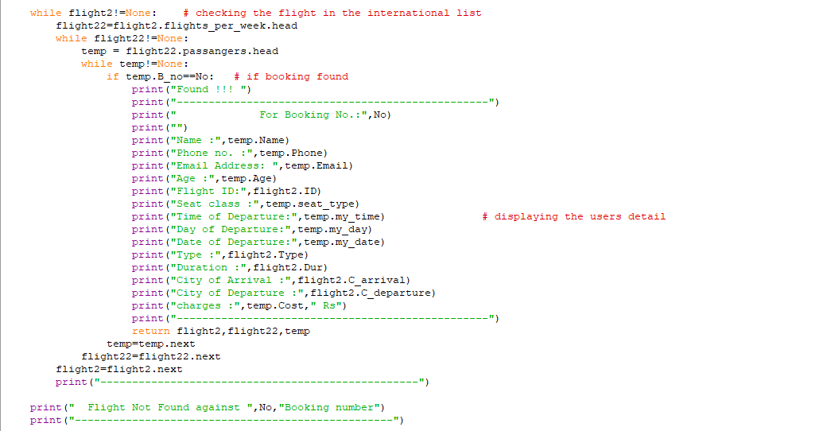

Slide 41
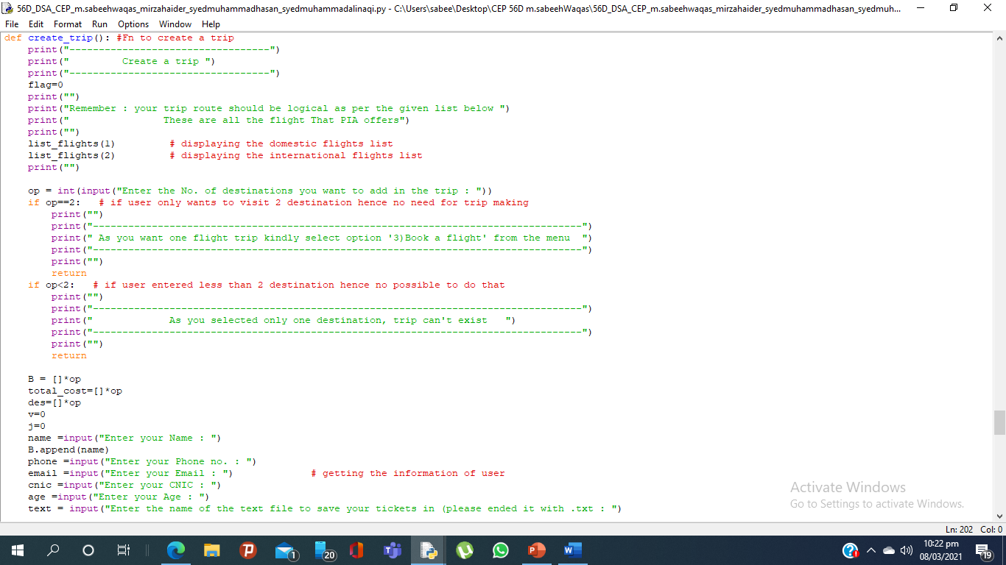
8) Function to Create Trip:
Function is used to create trip for the user , user has to enter the destination points and his/her details to create trip
Note: trip is only saved for run time(not in database separately as a trip)
trip is saved by the username

Slide 42
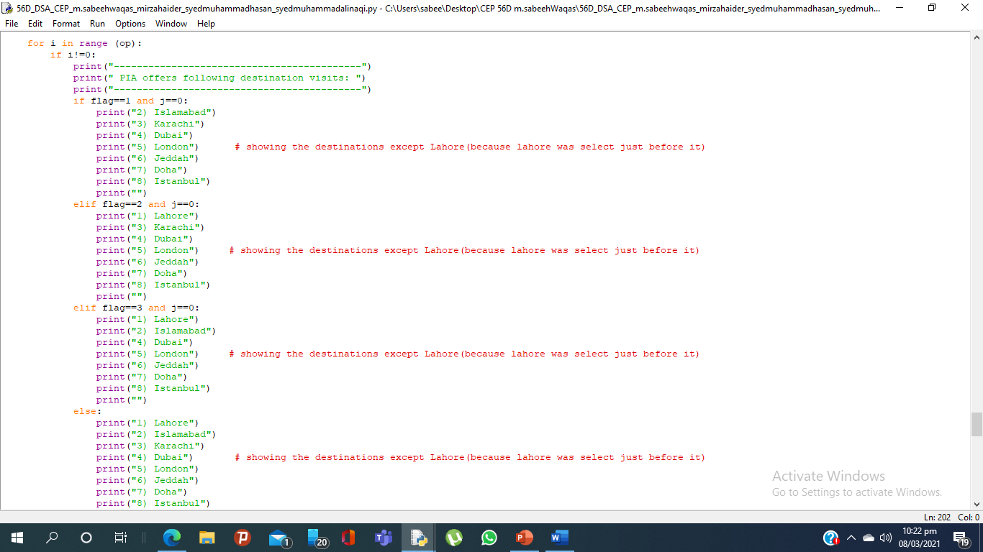

Slide 43
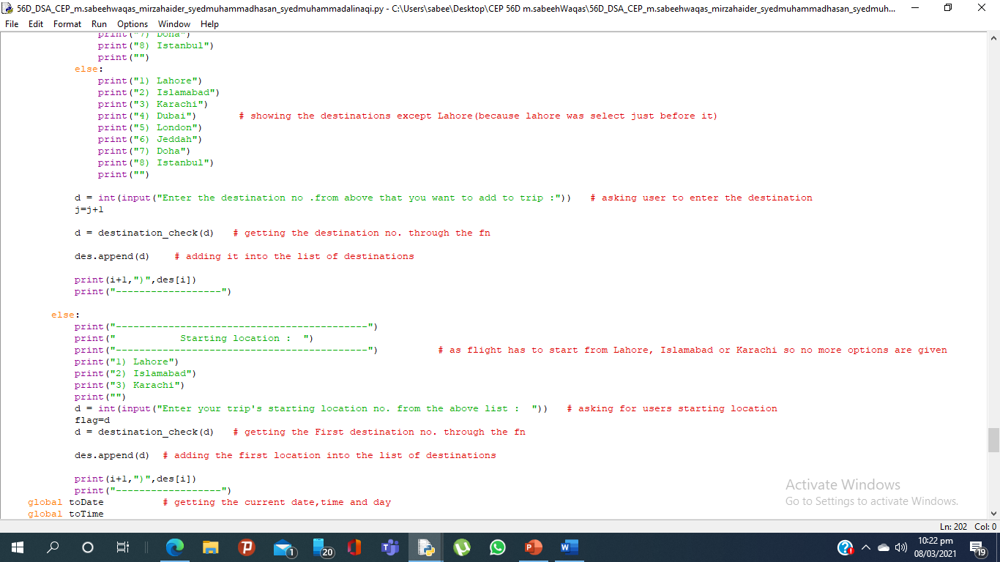

Slide 44
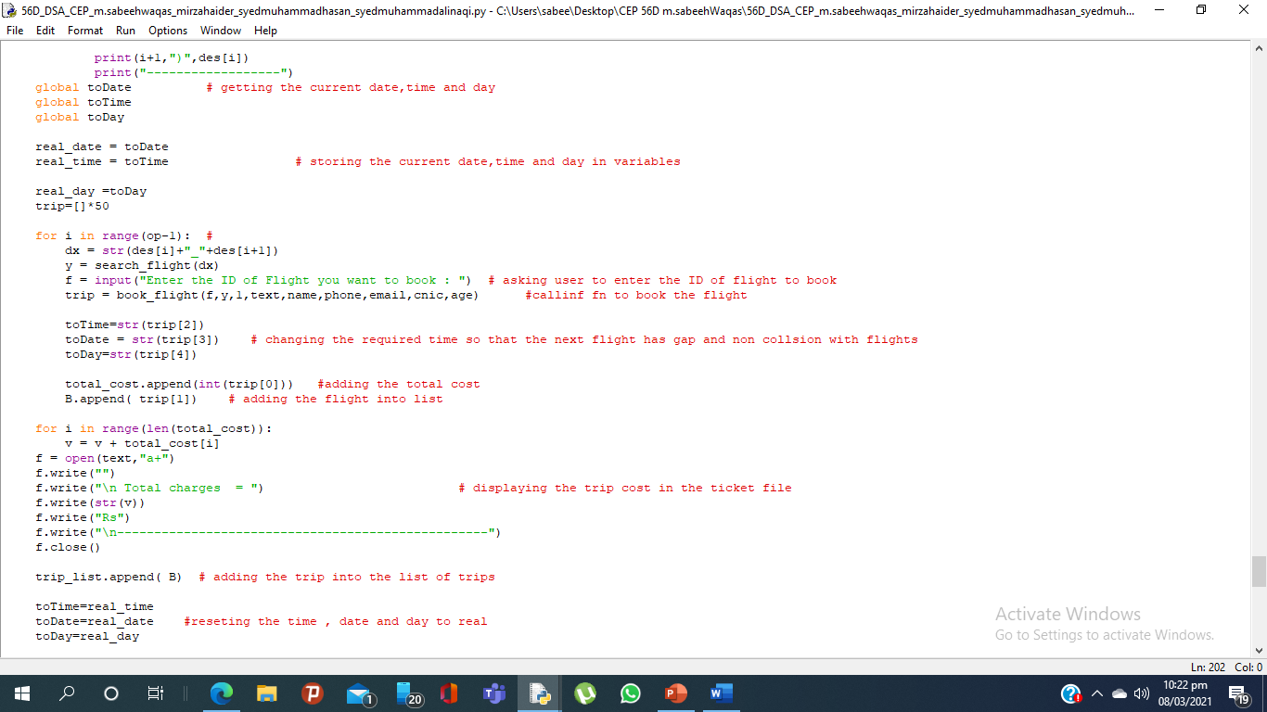
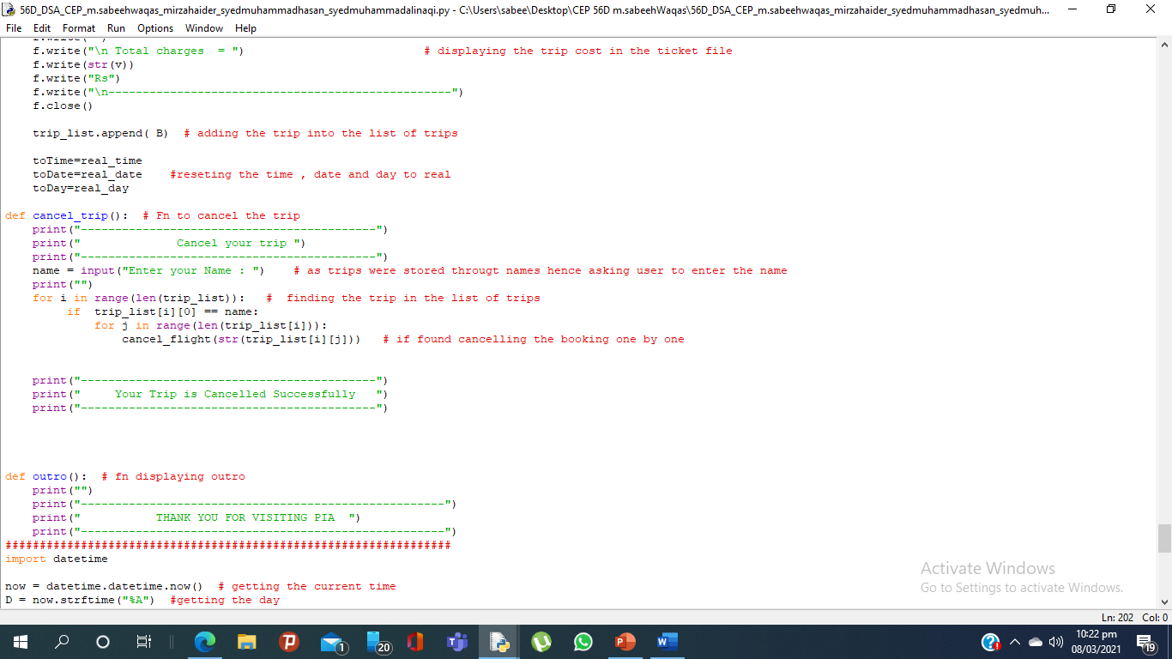

Slide 45
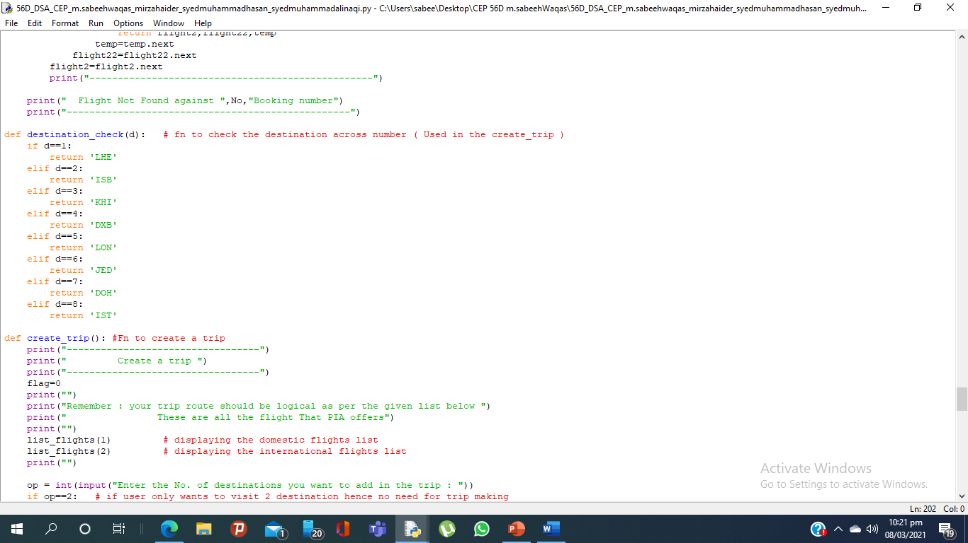
i)Supporting Functions:
Functions to convert destination number from list into string aka flight name that ptogram can understand

Slide 46
9) Function to Cancel Trip:
Function is used to cancel the trip for the user , user has to enter his name

Slide 47
Other Functions in program:

Slide 48
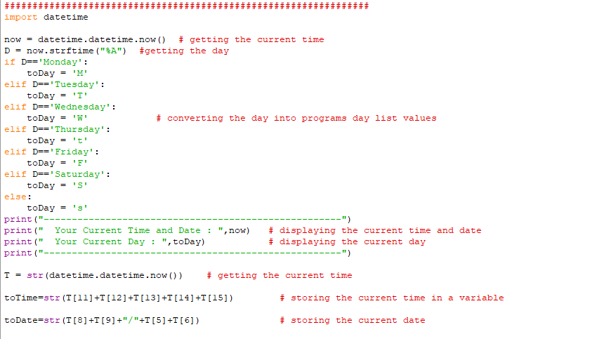
Function to get the real current date and day

Slide 49
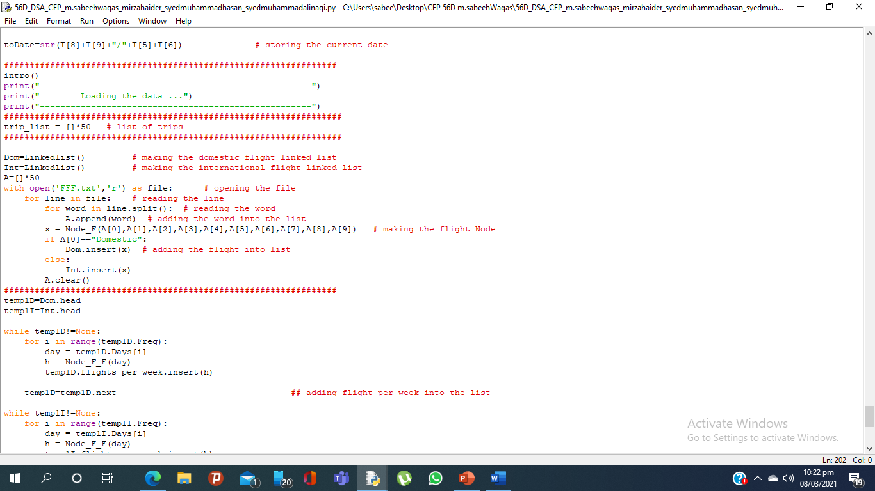
Calling intro fn
Making trip list
Making linked list of domestic and international flight and loadinfthe flights into the lists from the file “FFF”

Slide 50
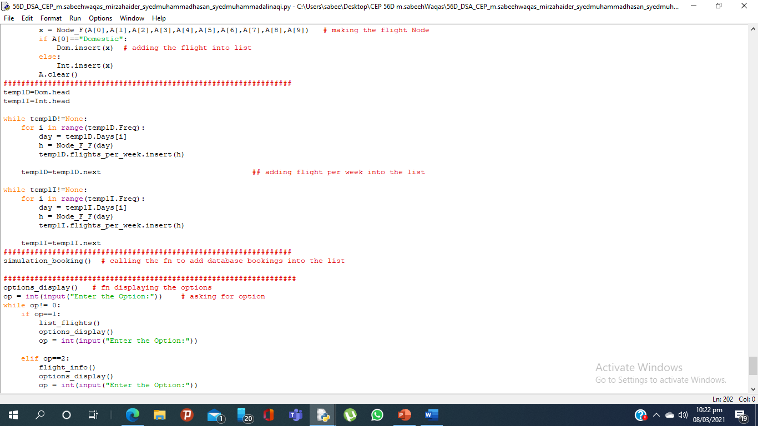
Adding per week Flight list into the flight list
Calling fn to add database booking into the list

Slide 51
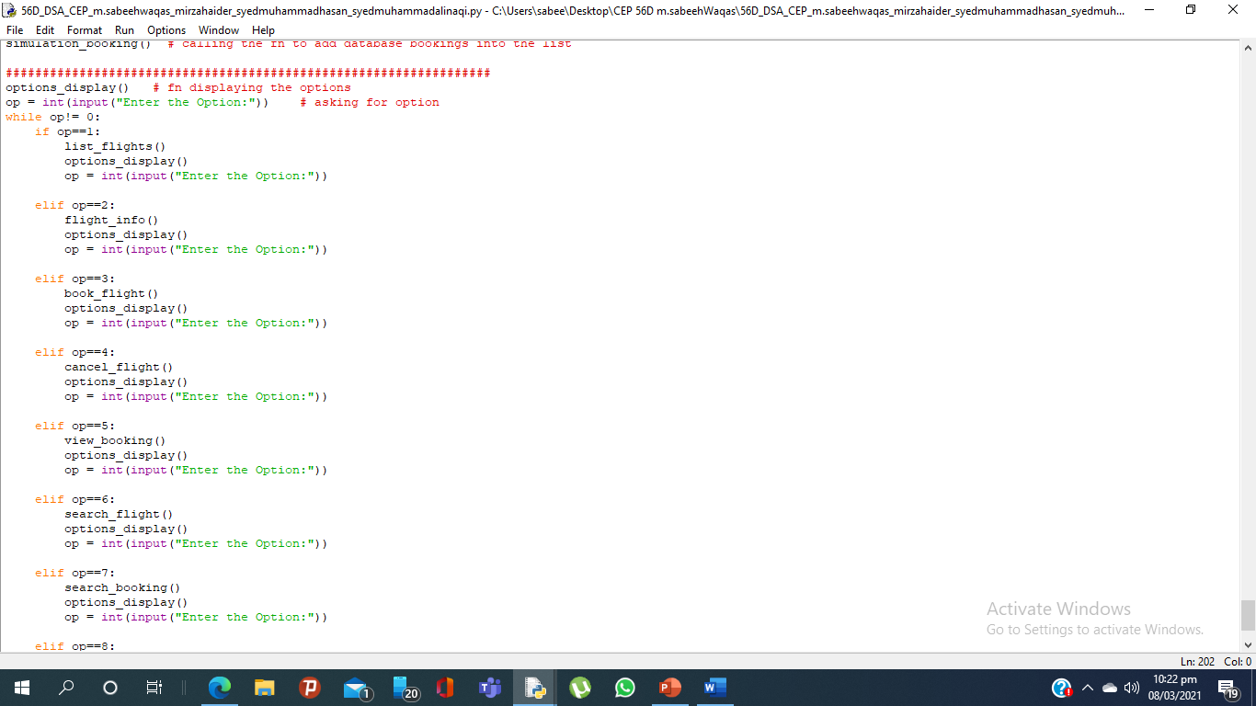
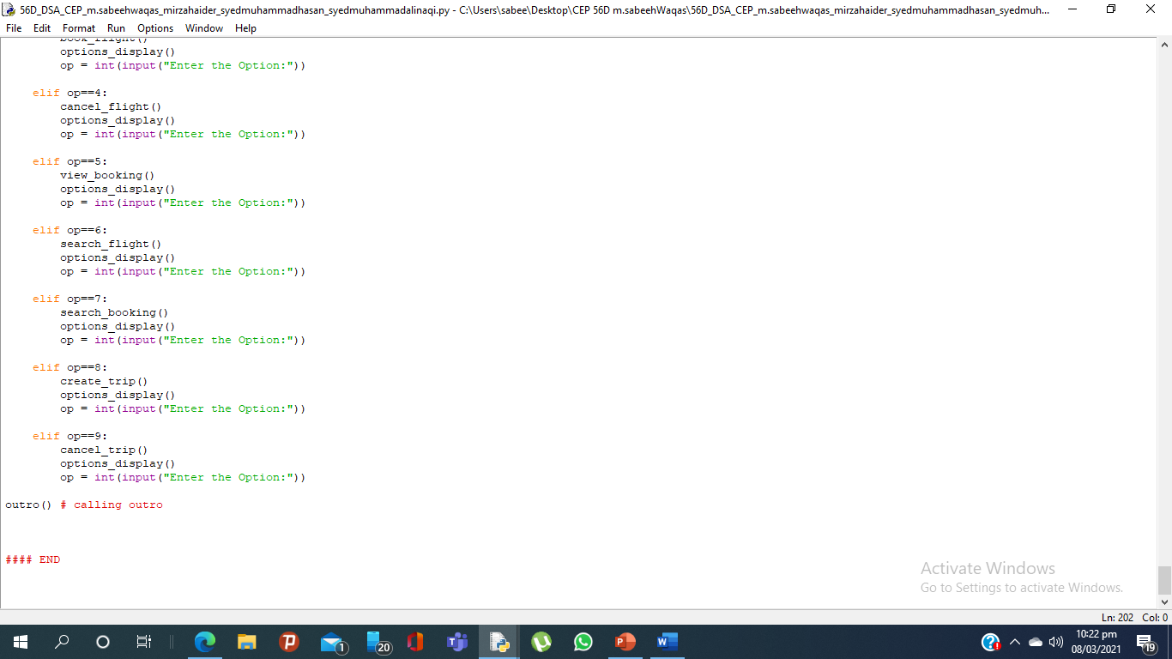
Displaying the user menu and calling fn’s according to the selection

Slide 52
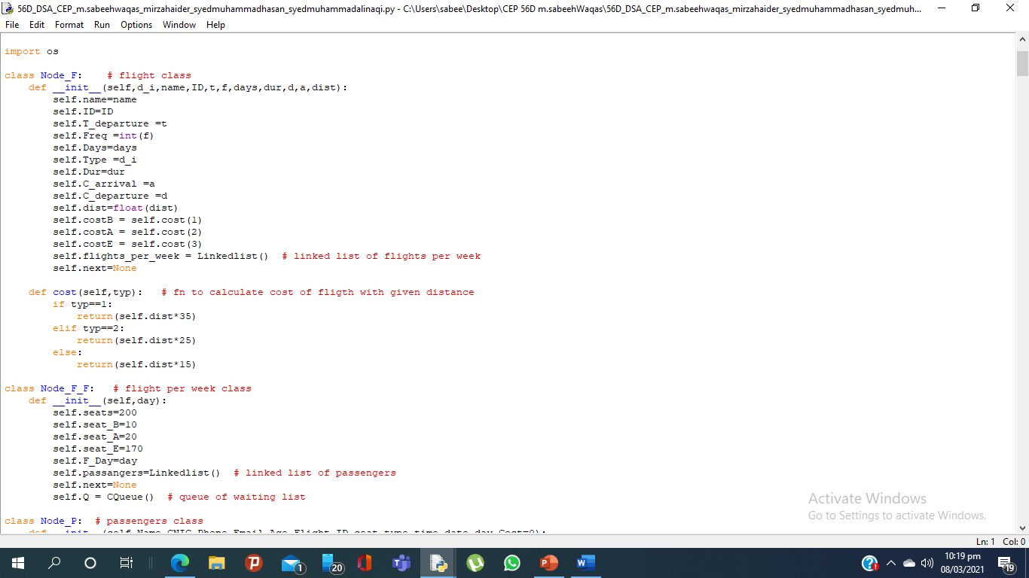
Function to convert distance into the cost

Slide 53
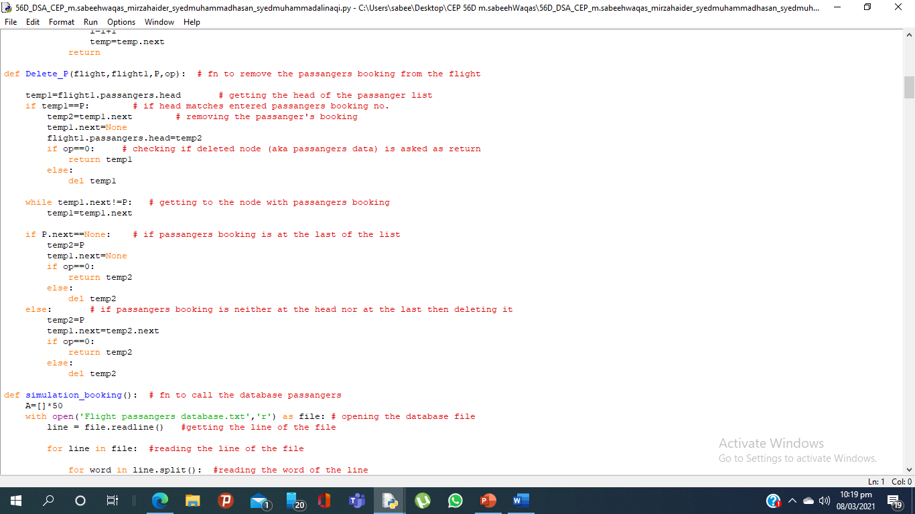
Function to delete passangers node from the list

Slide 54

Function adding the database booking into the list
Intro display function
Function displaying the options to user

Slide 55


Function used to book the flights from the database Note :similar to the book a flight function

Slide 56

Cont..

Slide 57
Feature and limitations:
our program contains Linked list queue and python list.
our structure is:
Two linked lists (Domestic and international) each having all the flights in linked list nodes.
Each flight has linked list of day wise flight.
Each day wise flight has linked list of passenger’s data.
our program work on weekly schedule i.e., flights are rescheduled weekly according to user’s current time.
we can load add or remove flights from program just by using FFF text file.
our flight simulation database is Stored in file “Flight passangers simulation” this database only work for the purpose of making database which means all the booking are added into the file and permanently stored but if we cancel the booking it is only cancelled for the specific runtime but not removed from the database
our program can handle collision of flights well.
in our program you cannot book flight for the same day as per 24hr prior booking policy if selected same day user will get flight for the next weeks same day
in our program CNIC is used to identify the user
in our program a single user cannot book two seats in the same flight under same CNIC
in our program automatically chargers are calculated from the flight’s distance
our “make a trip” is not stored in the file it is just for run time and deletes as program ends.
however, we can make trips as many as we want (to be resize 50) while running the program.

Slide 58
THANK YOU !

